Slide 1
E-Library
Website
Teknologi Mikro Services / Web Service

Slide 2
Anggota Kelompok
Reza Zaini Fahmi 192310011
Muhamad Alkahfi 202310063
Eki virgiana 202310061

Slide 3
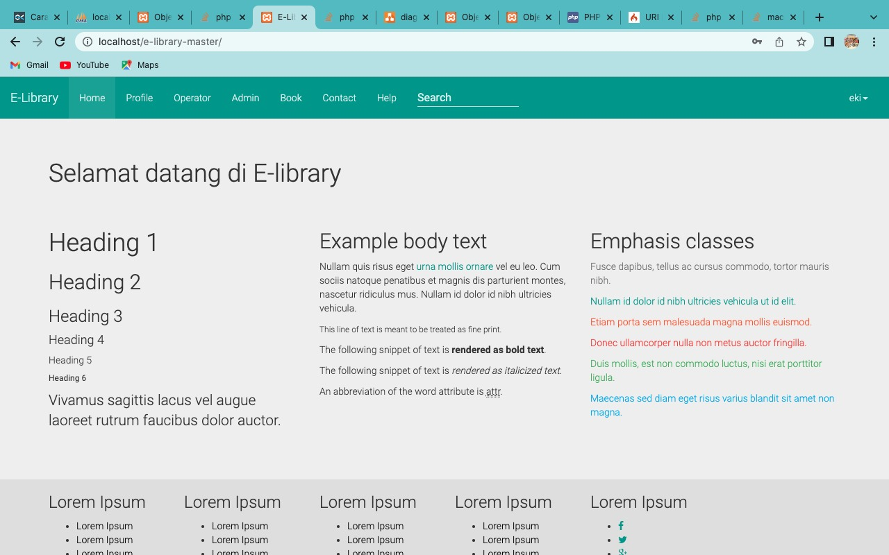
Website E - Library

Slide 4
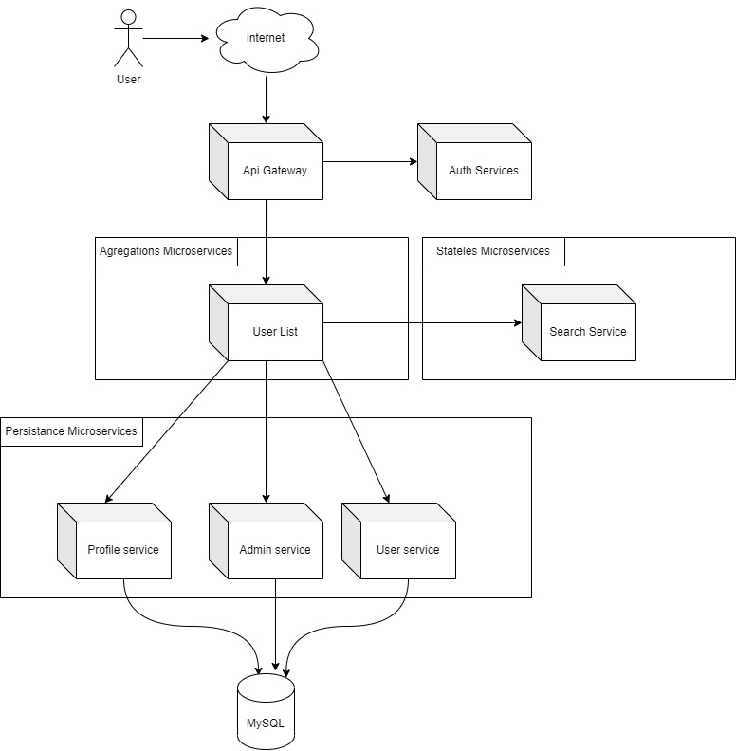
Architecture Services

Slide 5




Technology Used
[ FrontEnd ]
[ BackEnd ]
[ Database ]

Slide 6
THANK YOU
ANY QUESTIONS?

